Slide 1
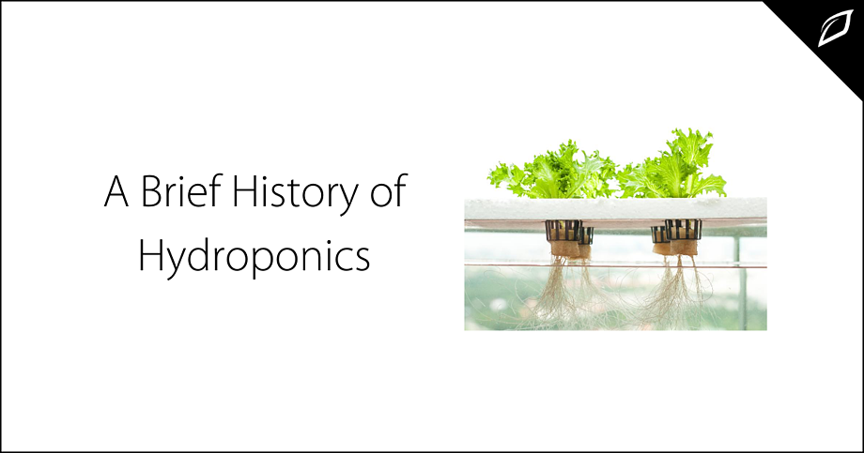
A Review on Project
STES’S SINHGAD ACADEMY OF ENGINEERING KONDHWA, PUNE 411048
IoT based Hydroponic System
Presented by :
Project group 48
- Komal Naphade(B018)
- Pranav Gavali(B046)
- Dhiraj Shelke(B071)
Guided by :
Prof. P. R. Patil

Slide 2
Outline
Introduction
Motivation
Problem Definition
Literature Survey
Software Requirements Specification
Hardware Requirements Specification
Project Scope
Project Timeline chart
Assumptions and Dependencies
Architecture
Mathematical model
Algorithms
Data Flow Diagram Level-0,
DFD Level-1,
DFD Level2.
UML Diagrams
Partial Implementation
Conclusion.

Slide 3
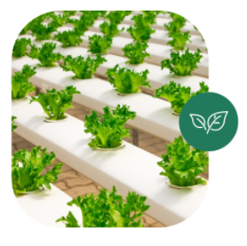
Introduction
Hydroponics is a technique of growing plants without soil and without the limitations of space and climate.
In the traditional farming system, plants depend on soil to obtain all nutrients needed for their growth.
In contrast, a hydroponic garden provides all of these nutrients without involving sunlight, soil, extra labour, allowing farmers to benefit from efficiencies and to reap large produce yields.

Slide 4
Photosynthesis process :
Carbon Dioxide + Water -> Glucose + Oxygen
6CO2 + 6H2O -> C6H12O6 + 6O2
There is no mention of “soil” anywhere in there and that’s all the proof you need that plants can grow without it.
Plants require 17 essential elements to grow and reproduce
The first three are Hydrogen, oxygen and carbon
Other 14 are:
Macro-Elements: Nitrogen, Phosphorous, Potassium, Calcium, Magnesium, Sulphur
Microelements: Iron, Manganese, Copper, Zinc, Boron , Chlorine, Molybdenum, Nickel

Slide 5
Nutrient Solutions
In Hydroponics, Nutrient control is easy
It consists of a nitrogen rich grow formula
A phosphorous and potassium rich bloom formula
And the results ?
Bumper crops of delicious fruits and vegetables every time.

Slide 6
Motivation
Have a Mobile & Dynamic setup
To design efficient systems in terms of water usage, and a higher crop yield.
Reduce inefficient and Destructive farming
To increase awareness relating to the benefits of Hydroponics.

Slide 7
Problem Definition
Every plant grown using open agriculture farming, ties up a certain amount of land for a long duration (usually through the growing season).
Agriculture uses lots of water.
Agriculture farming takes lot of time to produce outputs.
Conventional Farming uses lot of Manpower

Slide 8
Literature Survey
Sr. No | Topic | Author | Year | Major Findings
1 | iPONICS: IoT Monitoring and Control for Hydroponics IEEE Conference | K. Tatas, A. Al-Zoubi Antoniou D. Zolotareva | 2021 | The system is composed of a specialized Wireless Sensor Network. This System also provides the user with a user friendly web-based tool to monitor his crops as well as being appraised by appropriate alarms and warnings.

Slide 9
Literature Survey
Sr. No | Topic | Author | Year | Major Findings
2 | Hydroponics System for Soilless Farming Integrated with Android Application by Internet of Things and MQTT Broker – IEEE Conference | Navneet K. Bharti Mohit D. Dongargaonkar Isha B. Kudkar Siuli Das Malay Kenia | 2019 | Single micro-controller and basic sensors are used. Internet of Things is used to accumulate the data and store it on servers. An Android application is used to fetch this data, creating a more personalized setup and data.

Slide 10
Literature Survey
Sr. No | Topic | Author | Year | Major Findings
3 | Automated Irrigation System Using a Wireless Sensor Network and GPRS Module - IEEE Transaction | Joaquín Gutiérrez, Juan Francisco Villa-Medina, Alejandra Nieto-Garibay, and Miguel Ángel Porta-Gándara | 2014 | The system consisted of two components wireless sensor units (WSUs) and a wireless information unit (WIU) The WIU has also a GPRS module to transmit the data to a web Configuration of the automated irrigation system. The information can be remotely monitored online through a graphical application through IoT.

Slide 11
Literature Survey
Sr. No | Topic | Author | Year | Major Findings
4 | IoT Based Automated Hydroponic Cultivation System – IJAER Journal | Dr. Ponmurugan Sudharsan, Vargunan, Vignesh Raj , Selvanayagan | 2019 | By the intervention of IoT this whole hydroponic system can be automated. All the data from the hydroponic system are sent to the cloud data for the automation purpose. The health condition of the crops is monitored with data collected by the sensors and actuators.

Slide 12
Software Requirements Specification
Open Source Languages & Libraries
Arduino
Blender for Creating model

Slide 13
Hardware Requirements Specification
pH Control
Horticulture Lighting( Grow Lights )
Pipes to transfer fluids
A Controller to control the System (Arduino)
Switches and Regulators
Nutrients

Slide 14
Project Scope
Manual Integration of Sensors
Using IoT Devices like Arduino with sensor interfacing
Besides project scope, there are intangible skills we look to gain as well.

Slide 15
Project Timeline Chart
Analysis
Just the basic Survey of the Project and Study of Research Papers
Duration : 3 – 4 Weeks
Requirement
Gathering
Collection of all required components and firmware for the project
Duration : 1 Month
Design and Deployment
Proper project overall design by creating models before actual implementation
Duration : 3 – 4 Weeks
Implementation
Testing
Implementation of Project on the basis of requirement gathering and design models planned previously.
Duration : 1 – 2 Months
Testing the actual project on the basis of different aspects.
Duration : 1 Month

Slide 16
Assumptions and Dependencies
You’ll have access to all the resources you need to complete the project, both human and material.
Project team members will have the resources they need to complete their individual tasks on time, from specialized equipment and software down to electricity during working hours.
Personnel costs will not change during the project cycle.
Other material and resource costs will remain consistent throughout the project.
The overall cost of day-to-day operations will not increase.
All equipment will be in working condition through the project cycle.
Most important Dependency is the location where the system is built. It should be spacious enough.

Slide 17
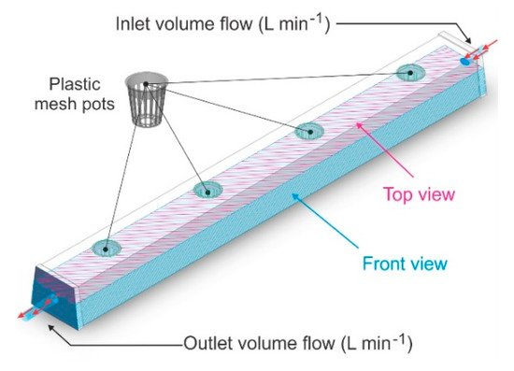
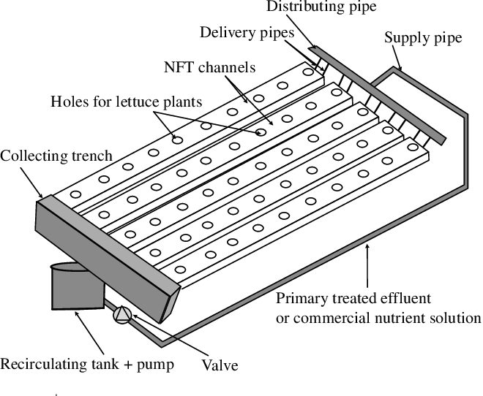
Architecture

Slide 18
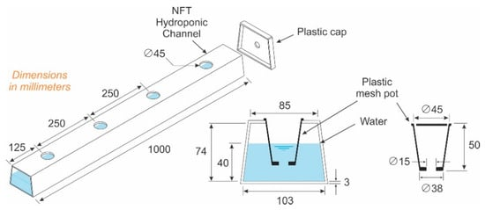
Architecture

Slide 19
Mathematical Model
Micronutrients + Macronutrients = Total Nutrients required(N)
Total Nutrient(N) + Water(W) = Nutrient Solution(NW)
Check Potential of Hydrogen Level(pH)
pH(NW) < 7 = Acidic Water
pH(NW) > 7 = Basic water
pH(NW) = 7 = Neutral Water
Make sure to have appropriate pH level for particular plant
G(p)= Water Circulation Time + Amount of Nutrient Solution
Where G(p) = Growth of plant

Slide 20
Algorithms
Step 1: Start
Step 2: Set Op-time of Grow Light with desired intensity
Step 3: Set Op-Time of Water circulation
Step 4: Set-up Temperature Sensor
Step 5: Turn on the Sensors
Step 6: Add nutrients to water
Step 7: Regulate water supply
Step 8: Check for Water Level after Circulation
If Level is not as desired Level :
Go to Step 7
Step 9: Check pH Levels
If pH level is not as desired:
Go to Step 6
Step 10: Stop

Slide 21
Data Flow Diagram – Level 0
Start
Adding Seed
Providing
Essential
Nutrients
Reap
Healthy Crop
Stop

Slide 22
Data Flow Diagram – Level 1
Start
Initialize Sensors
Read and Record Sensor Data
Check Water Requirement
Read pH Value of Supplied Water
Add Nutrients
Stop

Slide 23
Data Flow Diagram – Level 2
Start
Initialize Sensors
Set Communication between sensors and Controller
Read and Record Sensor Data
Acquire data on Stage of growth
No
Water Tank level at set point ?
Yes
Turn on Water Supply
Turn off Water Supply
Read pH Value of Supplied Water
Is pH = desired pH level ?
No
Add Nutrients
Yes

Slide 24
UML Diagram
Sensing System
Response System
Temperature
Water Pump
Environment Data
Arduino
Control Instruction
Water Level
Nutrient Supply
Timer
Timer
Light

Slide 25
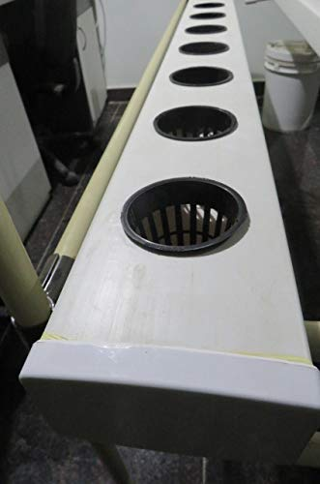
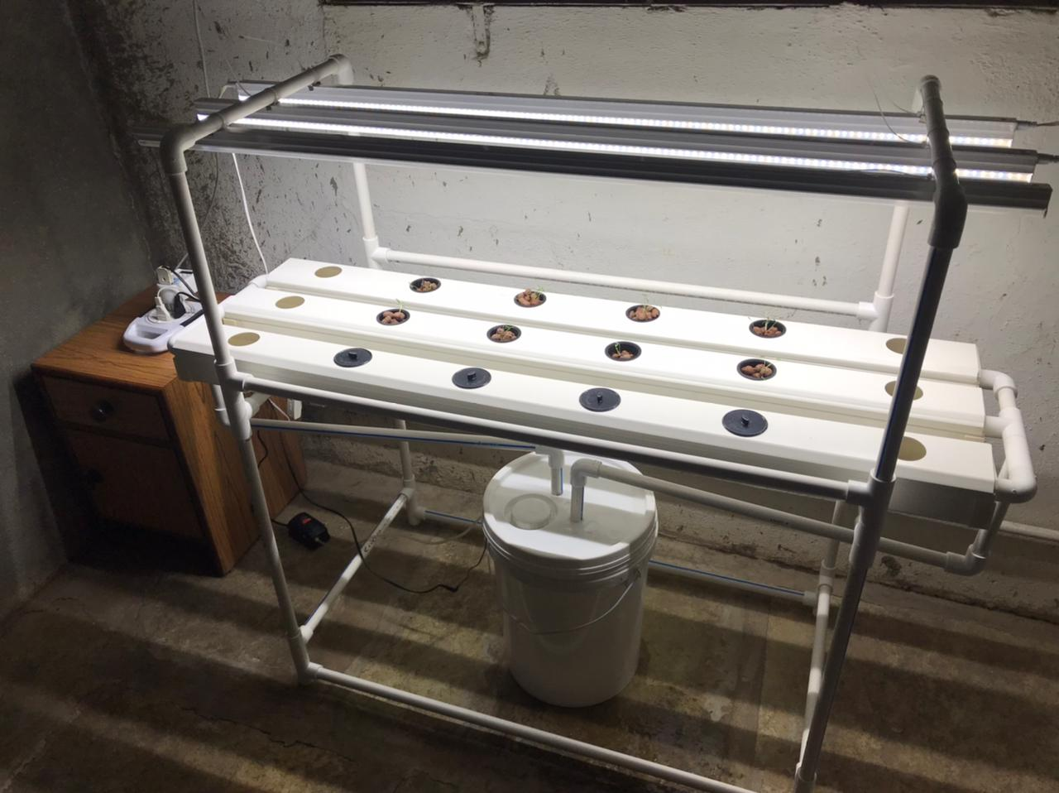
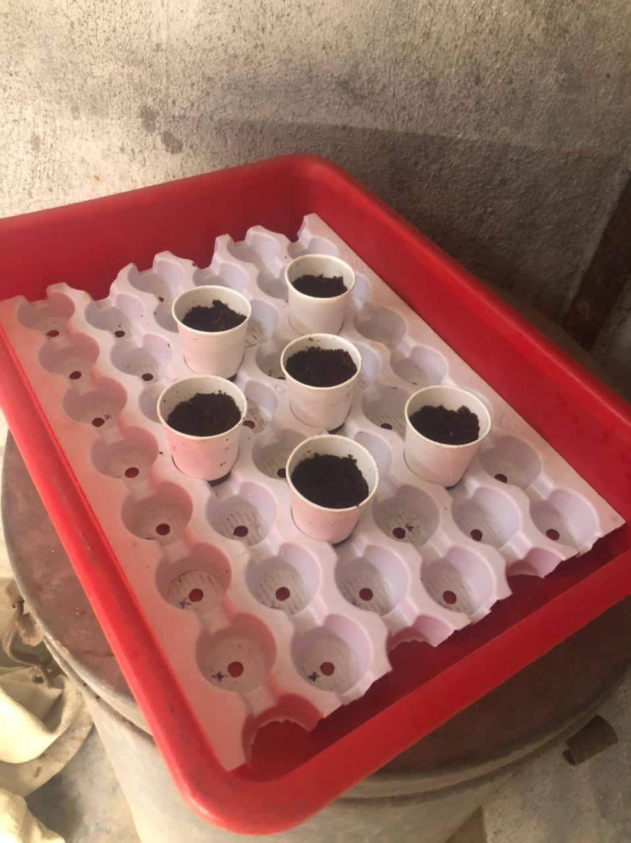
Partial Implementation

Slide 26
Conclusion
Hydroponics is the effective technology for the places of the world having scarcity of infertile and arable land for cultivation of crops. Fresh products can also be harvested through hydroponics throughout the year as it is not like traditional cultivation practices.
Additionally technologies like Deep Learning can help to boost this sector and help deploy it for millennials. As observed, we can conclude that using such technologies can help us increase crop yield over 70% and reduce the cost significantly ‘over-time’ as well.

Slide 27
Thank you !

